Slide 1
Corporate Relations University Advancement Broader Impacts of Research: Strategies, Resources, and Partners 2021 Conference
March 18, 2021

Slide 2
Corporate – University Engagement MSU’s University Advancement Corporate Relations (UA-CR) team is a gateway to MSU’s greatest resources—knowledge and people. We partner with the corporate community, and university faculty and staff, to foster strategic relationships that advance both the objectives of industry and the mission of the University.
Colleges & Academic Units
Private Support
Philanthropy, Gifts & Grants
Advisory boards, Centers & Institutes
Corporate relations
Research Collaborations
Talent
Student recruiting & engagement.
UA-CR partners with MSU Business Connect
Business Services
Commercialization & Licensing
Executive & continuing education, consulting
UA-CR partners with MSU Innovation Center

Slide 3
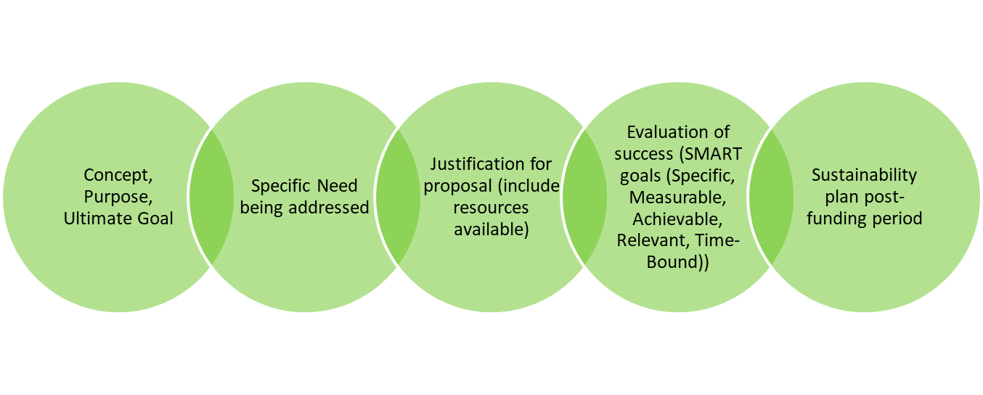
Corporate Relations Funding Facts
Corporate Relations Goals:
Raise awareness of MSU
Increase corporate and corporate foundation giving
Foster interdisciplinary collaborations
Build a communication plan to highlight corporate partnerships
How can we help?
Raise awareness across campus and foster collaboration
2. Provide you with insight regarding corporate
partners and their current funding (if any)
Coach you on strategy and proposal development
Plan and coordinate site visits
Gifts can take 12-18 months to actuate
Funding can enhance existing programs or help start new programs
Funding is generally for 1-2 years and non-renewable
Think beyond the funding to the relationship!

Slide 4
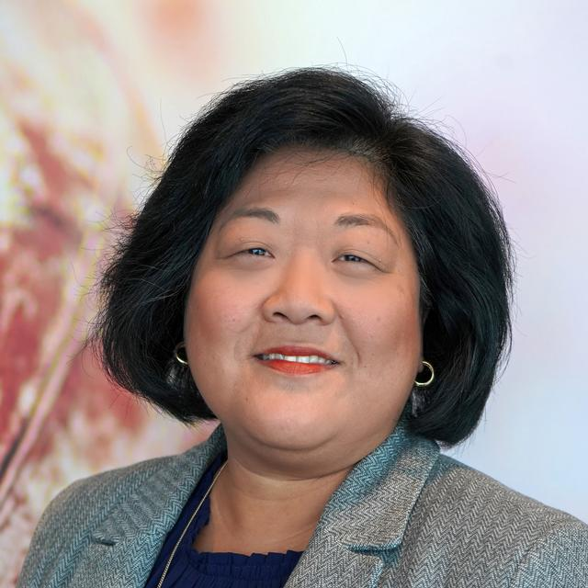
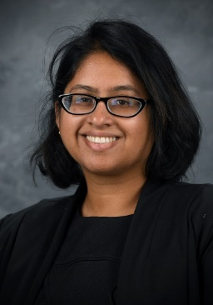
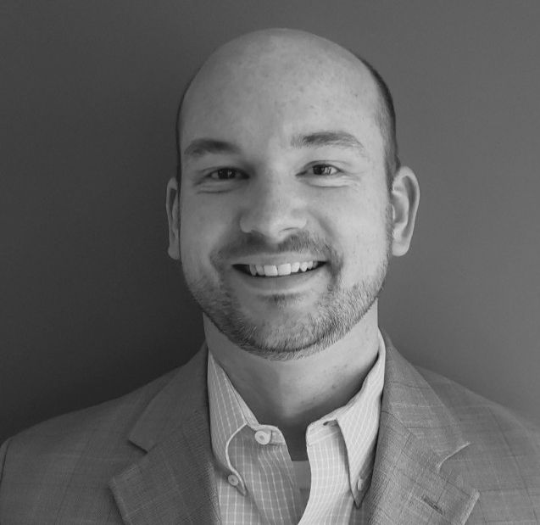
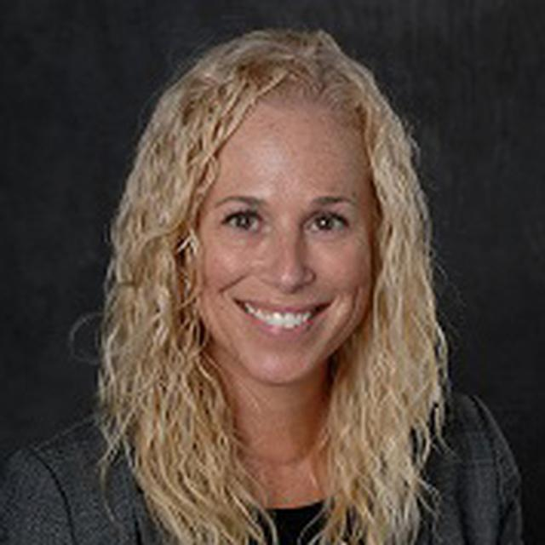
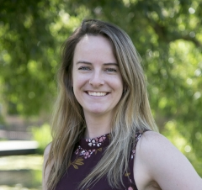
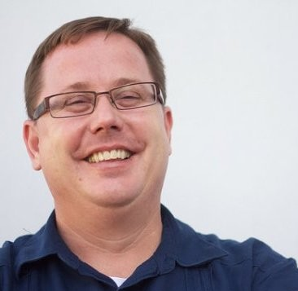
CORPORATE RELATIONS TEAM
Kyan Zeller
Senior Director
(FinTech/Insurance, Media)
Deepa Srikanta, Ph.D.
Director, Biomedical/Life Sciences (Biomedical/Life Sciences, Food, Health)
Andy Cleland
Associate Director
(Mobility, Manufacturing, Technology, Consumer Goods)
Jennifer Jennings
College of Engineering, CFR
(Suppliers [select], EGR centric)
Open
Agriculture and Natural Resources, CFR
(Packaging)
Anna Linn
Broad College, CFR
(Hospitality, Accounting, Consulting)
Michael Lindhout
International Studies & Programs, CFR

