Slide 1
Measuring Engagement: What are We Learning?
Burton Bargerstock
Director, National Collaborative for the Study of University Engagement
Director, Communication and Information Technology
Special Adviser to the Associate Provost
Association of Public and Land-grant Universities
Summer Meeting of the Council on Engagement and Outreach and
Commission on Innovation, Competitiveness, and Economic Prosperity
Chicago, Illinois
July 12, 2016

Slide 2
Historical Context for Collecting this Data
MSU founded as nation’s pioneer land-grant institution (1855), establishes long-term commitment to societally useful research, access, extension, and public service
Recognized as one of the nation’s most research intensive institutions, MSU is offered membership in the Association of American Universities (1964)
MSU receives W. K. Kellogg Foundation grant to support institution-wide realignment efforts focused on outreach/engagement (1988)
University-wide outreach and engagement office, headed by Vice/Associate Provost, is established (1991)
A faculty-led Provost’s Committee on University Outreach is organized and defines outreach [and engagement] as: “a form of scholarship that cuts across teaching, research, and service. It involves generating, transmitting, applying, and preserving knowledge for the direct benefit of external audiences in ways that are consistent with university and unit missions.” (1993)

Slide 3
Historical Context (continued)
Engaged Research and Creative Activity | Engaged Teaching and Learning | Engaged Service
Community-based research Applied research Contractual research Demonstration projects Needs and assets assessments Program evaluations Translation of scholarship through presentations, publications, and web sites Exhibitions and performances | Online and off-campus education Continuing education Occupational short course, certificate, and licensure programs Contract instructional programs Participatory curriculum development Non-credit classes and programs Conferences, seminars, and workshops Educational enrichment programs for the public and alumni Service-learning Study abroad programs with engagement components Pre-college programs | Technical assistance Consulting Policy analysis Expert testimony Knowledge transfer Commercialization of discoveries Creation of new business ventures Clinical services Human and animal patient care
© 2009 Michigan State University

Slide 4
Historical Context (continued)

Slide 5
Historical Context (continued)
In its1993 report, the Provost’s Committee also formally recommended that the University:
Determine a means of assessing the quality of engagement and outreach activities
Establish a means for measuring, monitoring, and evaluating outreach [and engagement], with sufficient standardization to permit aggregation at the unit, college, and University levels, and sufficient flexibility to accommodate important differences across disciplines, professions, and units. (p. 14)
Incremental initial approach to data collection (1993-1998):
Review is conducted of University reporting forms
Modest revisions are made to several existing instruments
New narrowly-focused reporting instruments are created

Slide 6
Historical Context (continued)
Faculty committee authors Points of Distinction: A Guidebook for Planning and Evaluating Quality Outreach (1996), argues for assessing engaged scholarship across four dimensions:
Significance
Context
Scholarship
Impact
UOE began developing a university-wide data collection instrument (1998)
Comprehensive reporting on outreach and engagement
Influenced by Points of Distinction
Iterative development process
MSU promotion and tenure guidelines were revised, aligning documentation requirements with Points of Distinction (2001)
MSU begins participating in national efforts (CIC, APLU) aimed at identifying measures (2002), which continue today

Slide 7
Historical Context (continued)
The Outreach and Engagement Measurement Instrument (OEMI), is adopted at MSU (2004), has been used each year since
MSU hosts representatives from over 60 universities in invitational conference on Benchmarking University Engagement (2005)
OEMI data used to support institution-wide self-studies for HLC/NCA accreditation and Carnegie classification in community engagement pilot (2005)
Other universities begin partnering to use the OEMI
OEMI received Innovation Award from the University Continuing Education Association Outreach and Engagement Community of Practice (2007)
OEMI data used to support Carnegie re-classification (2014)
Ongoing review of the Instrument and participation in national dialogue

Slide 8
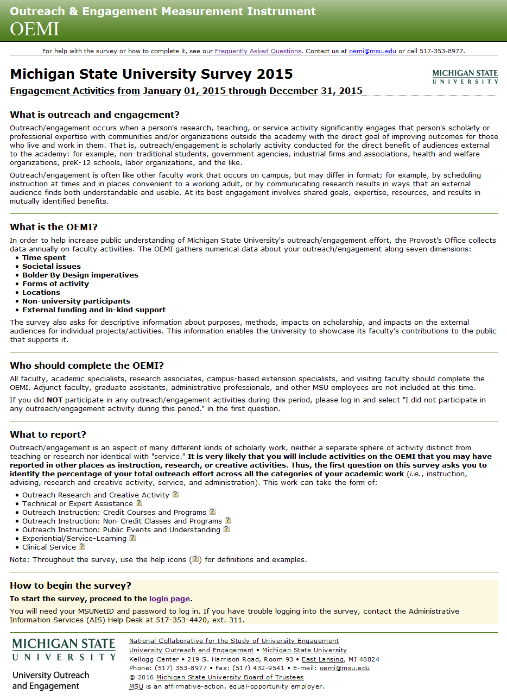
Outreach and Engagement Measurement Instrument
The OEMI is a survey that collects data on faculty and academic staff outreach and engagement activities
Process
Conducted annually
Institution-wide
Online, open 24x7, January-March
Reporting on effort in the previous calendar year
Respondents
Individuals, not units
Faculty and academic staff

Slide 9
Outreach and Engagement Measurement Instrument (continued)
The OEMI focuses on two units of analysis
Data on faculty effort
Time spent
Societal issues addressed
University strategic imperatives and priorities
Forms of outreach and engagement
Location(s) of intended impact
People served/involved
External funding support (to university and partners)
In-kind support (professional and volunteer time, material investments)
Data on specific projects
Societal issues addressed
Purposes
Methods
Duration
Michigan location(s)
Involvement of partners, units, and students
Impacts on external audiences
Impacts on scholarship
Creation of intellectual property
Evaluation

Slide 10
Data Collection with the OEMI at MSU: 2004-2015
3,935 distinct (non-duplicative) respondents have completed the survey
During this period the size of the faculty and academic staff has remained relatively stable (approximately 4,900)
Nearly 80% of respondents report having participated in some form of community-engaged scholarship or university outreach
The work reported by these respondents represents a collective investment by Michigan State University of $177,178,204 in faculty and academic staff time devoted to addressing the concerns of the state, nation, and world through engaged scholarship (based on the actual salary value of time spent, as reported by respondents)
Respondents have submitted 9,371 project reports

Slide 11
Utilizing Data about Community-Engaged Scholarship and University Outreach
Centralized data can serve a variety of purposes
Describing engagement and outreach activity (telling the engagement story)
Communicating examples across disciplines and sectors
Helping faculty develop better understandings of what community-engaged scholarship might look like in their discipline/field
Helping stakeholders see the many ways in which the University partners with communities, businesses, government agencies, schools, NGO’s, etc.
Recognizing exemplars
Helping the institution represent what it considers to be high quality community-engaged scholarship
Helping the public understand that the University values engagement

Slide 12
Utilizing Data (continued)
Supporting the President, institutional leadership, and externally facing offices (e.g., university development, government relations, communication, etc.)
Responding to accreditation and other institutional self-studies
Conducting assessments and strategic planning
Documenting the salary investment of a university’s contributions of scholarship for the public good
Supporting faculty, academic staff, and graduate student professional development efforts
Cataloging engagement opportunities and outreach programs to promote public access
Source of data for original research studies
Assisting faculty networking efforts in particular communities and/or around specific topics
Mapping the locations of partnerships

Slide 13
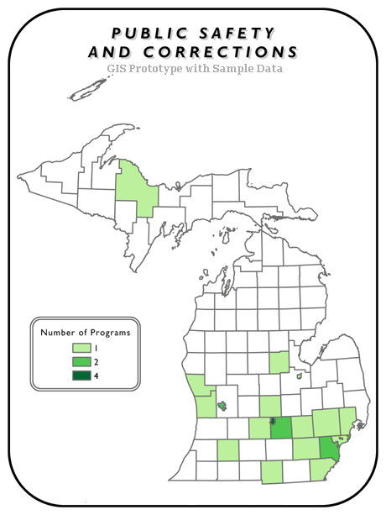
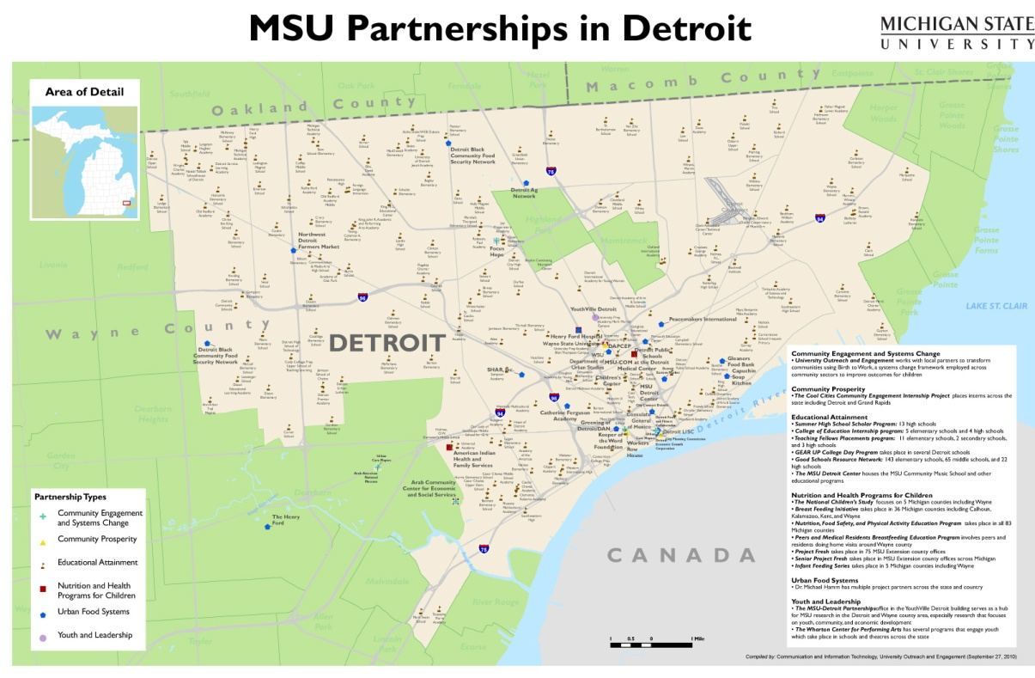
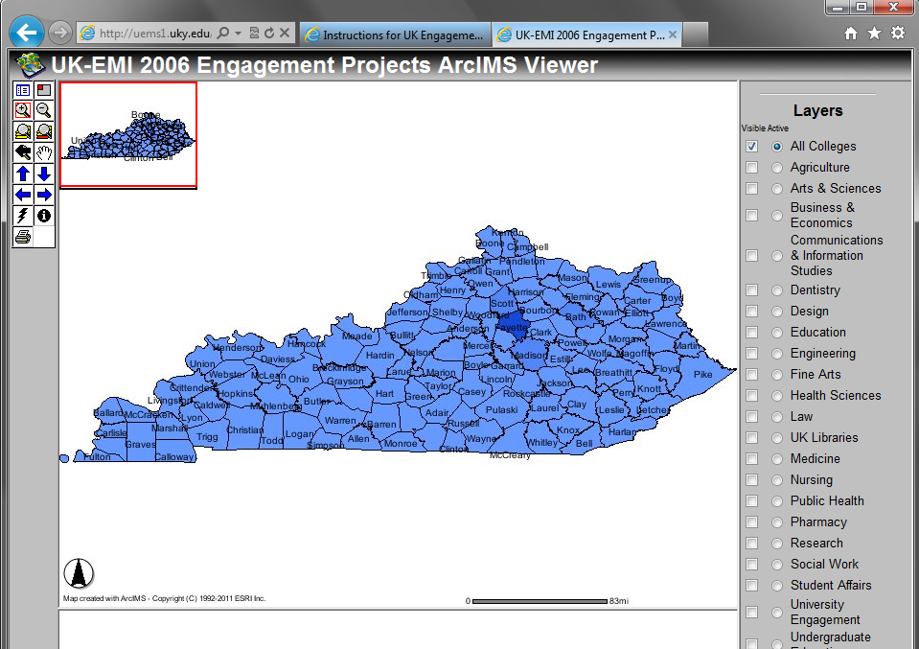
Utilizing Data about Community-Engaged Scholarship with Geographic Information Systems
Utilizing Data (continued)
GIS Prototype with Self-Reported Data (Non-OEMI)
Interactive Map of UK Engagement (University of Kentucky)

Slide 14
References
Doberneck, D. M., Glass, C.R., & Schweitzer, J. H. (2010). From rhetoric to reality: A typology of publicly engaged scholarship. Journal of Higher Education Outreach and Engagement 14(4), 5-35. Retrieved from http://openjournals.libs.uga.edu/index.php/jheoe/article/view/414/372
Michigan State University. (2004). Outreach and Engagement Measurement Instrument [Measurement instrument]. Retrieved from https://oemi.msu.edu/
Michigan State University. (1996, revised 2000). Points of distinction: A guidebook for planning and evaluating quality outreach . East Lansing, MI. Retrieved from http://outreach.msu.edu/documents.aspx
Michigan State University, Provost’s Committee on University Outreach. (1993). University outreach at Michigan State University: Extending knowledge to serve society. East Lansing, MI. Retrieved from http://outreach.msu.edu/documents.aspx

Slide 15
OEMI Demonstration System
Guest accounts for a fully functioning demonstration version of the Outreach and Engagement Measurement Instrument are available. To request one, complete the form at:
http://oemi.msu.edu/requestguestaccount.aspx
Contact Information
Burton Bargerstock
E-mail: bargerst@msu.edu
University Outreach and Engagement
Michigan State University Kellogg Center
219 S. Harrison Rd., Rm. 93 East Lansing, MI 48824
Phone: (517) 353-8977 Fax: (517) 432-9541
Web: outreach.msu.edu
© Michigan State University
Notes:
© 2007 Michigan State University Board of Trustees
15

